Slide 1
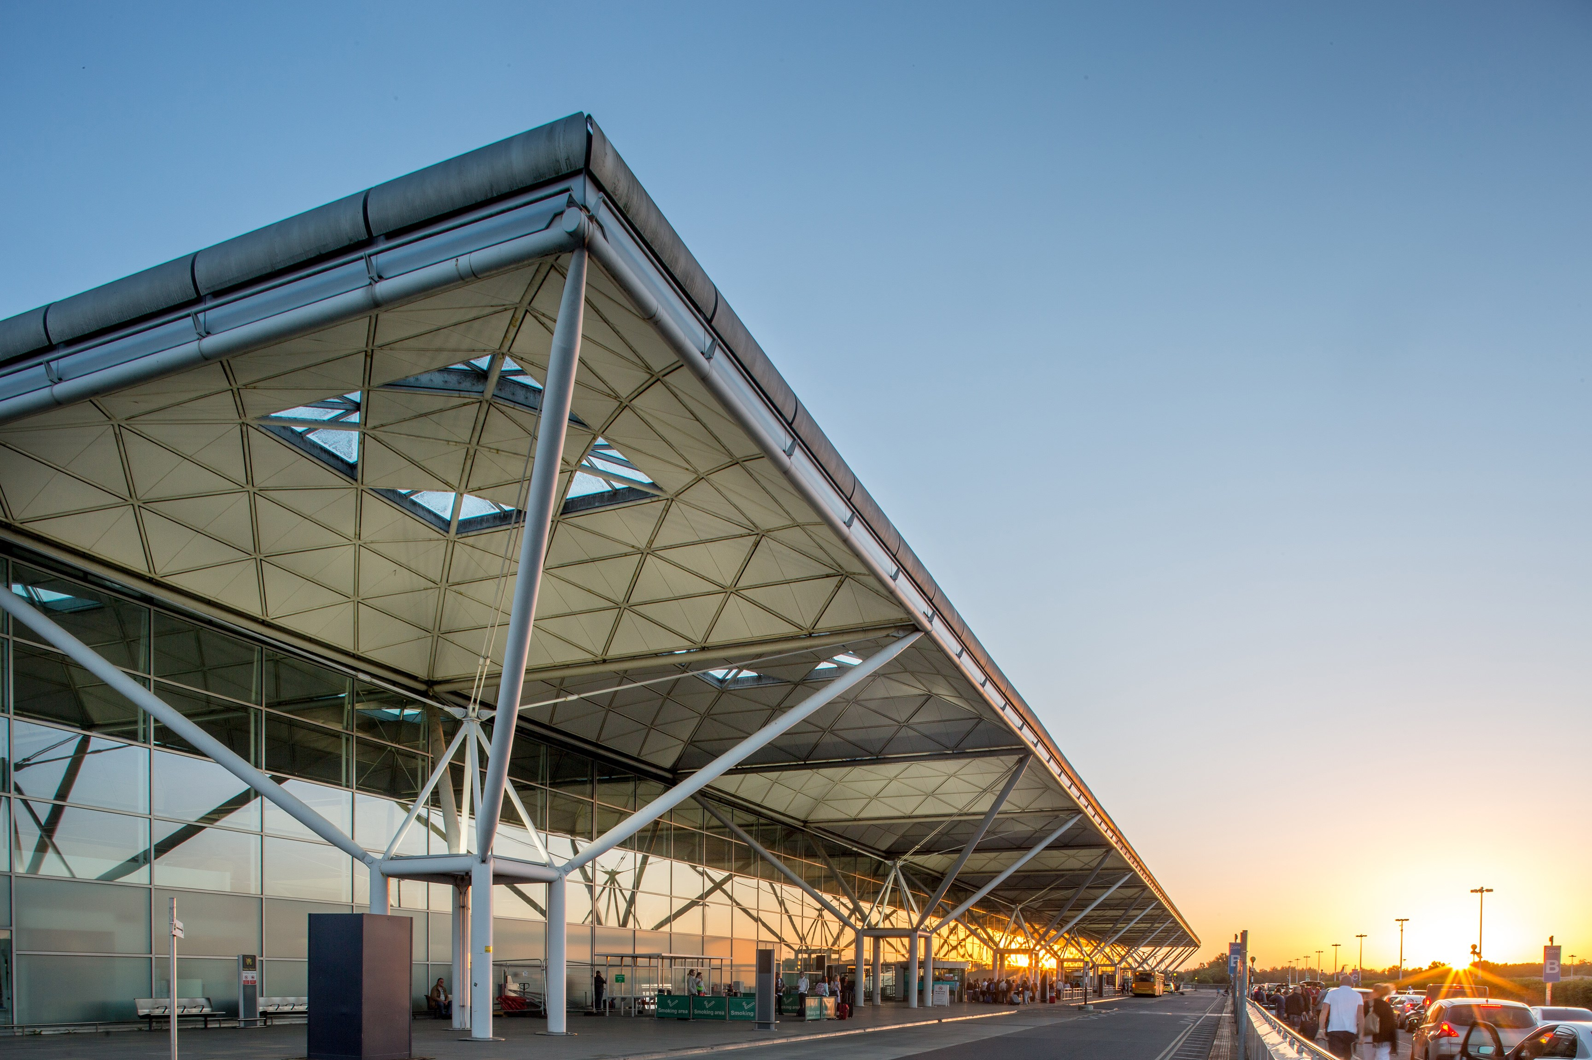
London Stansted Connecting to the world

Slide 2
Stansted’s role
UK plc
Aviation essential to UK export strategy and Global Britain agenda
Regional growth
Make best use of asset / our capacity for region
Linkage between an airport’s route network and the trade prospects of firms in region
STN growth
Attracting full service carriers in our commercial interests
We have capacity for growth up to 43m pax per annum
Route development and air corridors offer economic infrastructure that supports clusters

Slide 3
importance of Cambridge IN OUR catchment partnering with , - shop window for international investment into the city
London Stansted passenger penetration, 2019
37% of all London-USA traffic originated within the Stansted catchment in 2019
Acquisition of new routes determined by the right mix of volumes and yields from premium seats
Produces a vibrant scale-up community in Cambridge which we believe generates business travel demand
Greater Cambridge |  | 3.4 %
UK |  | 1.7%
Employment stats 2020-21
Sources: ONS, CAA Survey, Visit Britain

Slide 4
OBJECTIVES
Capture and present to airlines the demand for business travel out of Stansted – galvanising our stakeholders in pursuit of route expansion
Demonstrate the dividend available from route expansion – enhancing our role as an International Gateway for East of England
Test demand for business travel and long-haul connectivity
Explore regional dividend of route expansion
Communicate findings and mobilise stakeholders
SPRING | SUMMER | AUTUMN 2022
Research on regional businesses representing c.35,000 staff in regional workforce Series of roundtables with business leaders | Independent economic modelling of what key routes would do for region (Boston, San Francisco, Singapore, China) Stakeholder events/ briefings to share preliminary results | Report launch and summit (October) – bringing together airlines, regional businesses, MPs, government An ongoing partnership with regional businesses and stakeholders – harnessing your insight to build the case for route development

Slide 5
SOME OF OUR KEY FINDINGS…
WHO WE’VE SURVEYED SO FAR
Surveyed scale-ups and corporates across the East of England
Collectively, we’ve observed the travel patterns/needs of c.35,000 employees in the local workforce
Held three business roundtables with 23 companies, including:
GSK
Deloitte
Abcam (a £2.9bn company with over 1,100 employees)
and Cambridge Consultants (with 800 employees)
KEY FINDINGS
A significant majority (74%) of businesses anticipate their travel demand increasing in the next five years
Appears to be particularly strong demand for STN-BOS route, spurred by life sciences sector in Cambridge, and a STN-SAN FRAN route
Businesses would shift a significant portion of their flights to STN if direct routes to key destinations were offered
Convenience of STN is a major draw card versus other London airports

Slide 6
ECONOMIC DIVIDEND TO EAST OF ENGLAND OF ROUTE EXPANSION
STN-Boston
STN-San Francisco

Slide 7
NEXT STEPS
Summit and report launch in Cambridge in October – bringing together airlines, regional businesses, stakeholders and Government to demonstrate the demand for new services and the economic dividend of route expansion to the East of England.
Ongoing partnership – working with regional businesses and stakeholders in East of England to harness your insight and energies to build the ‘need’ for new services to key markets.
Collective endeavour – making the case for better surface access transport into airport and the restoration of four trains per hour on the Stansted Express.

